Slide 1



Project GenAI, RAG
Saúl Verdú

Slide 2
Business Case

Slide 3
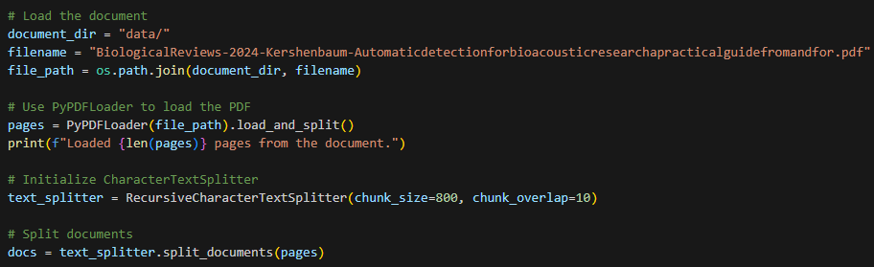
Dataset Loading

Slide 4

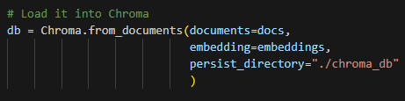
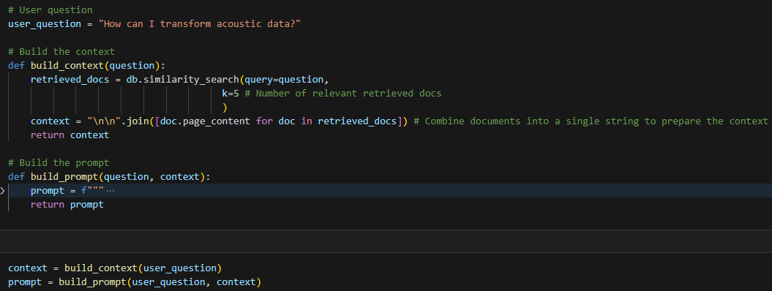
Retrieval-Augmented Generation

Slide 5
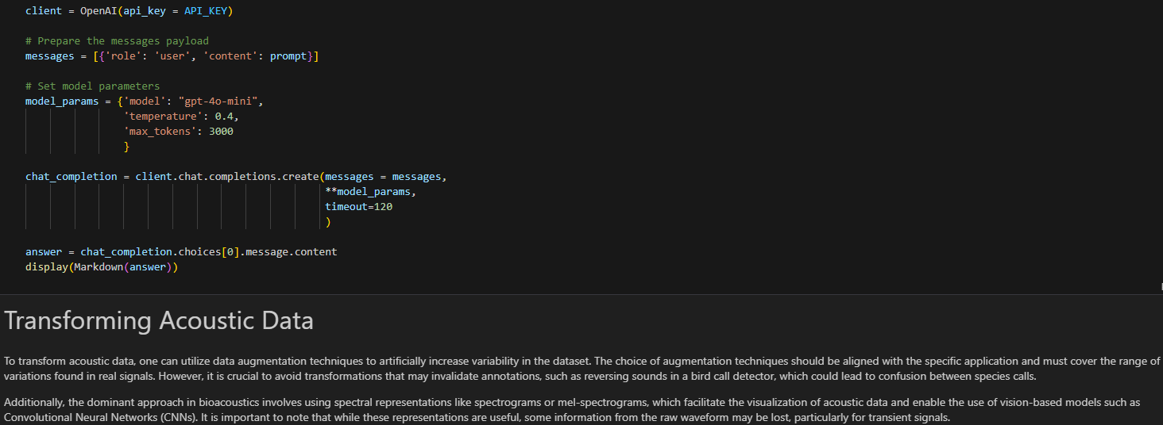
Generation

Slide 6
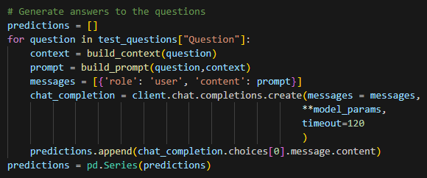
Test Questions

Slide 7
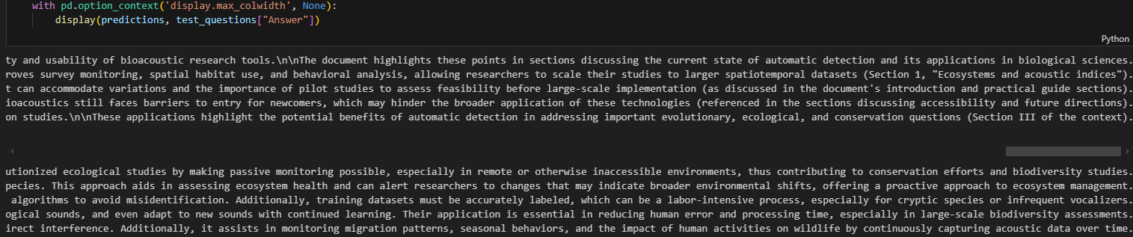
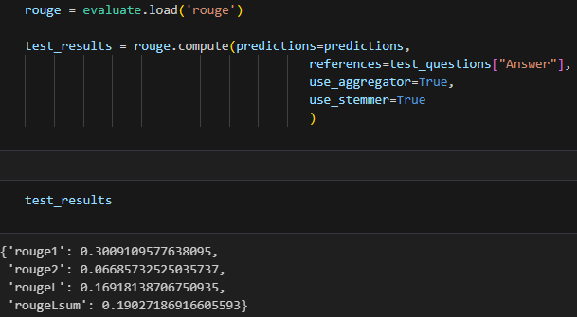
Evaluation

